Slide 1
IN 3230 / IN 4230 Oracle Session – Week 1
Praveensankar Manimaran
02/09/2021

Slide 2
Outline
Socket introduction and Unix sockets
Chat Application using unix socket

Slide 3
Section 1 – Socket Introduction and Unix Sockets

Slide 4
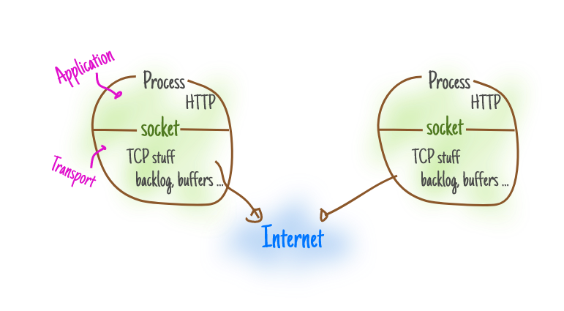
What is Socket ?
It's an endpoint used by processes to communicate with other processes
Each process will be identifier using a port number
[1] https://ops.tips/blog/a-tcp-server-in-c/
Fig: socket [1]

Slide 5
What is Socket ?
int socket(int domain, int type, int protocol);
Domain:
AF_INET – IPV4 protocol
AF_INET6 – IPV6 protocol
AF_UNIX – local communication (AF_LOCAL)
Refer the following link for more info:
https://man7.org/linux/man-pages/man2/socket.2.html

Slide 6
What is Socket ?
int socket(int domain, int type, int protocol);
Type:
SOCK_STREAM - sequenced, reliable, two-way, connection-based byte streams.
SOCK_DGRAM - Supports datagrams (connectionless, unreliable messages of a fixed maximum length)
SOCK_SEQPACKET - Provides a sequenced, reliable, two-way connection-based for datagrams
SOCK_RAW - Provides raw network protocol access
Protocol:
0 – to use default protocol
Refer the following link for more info:
https://man7.org/linux/man-pages/man2/socket.2.html

Slide 7
Unix Sockets
sockets for local interprocess communication
struct sockaddr_un
{ sa_family_t sun_family; /* AF_UNIX */
char sun_path[108]; /* Pathname */
};
Refer the following link for more info:
https://man7.org/linux/man-pages/man7/unix.7.html

Slide 8
Section 2 – Chat Application

Slide 9
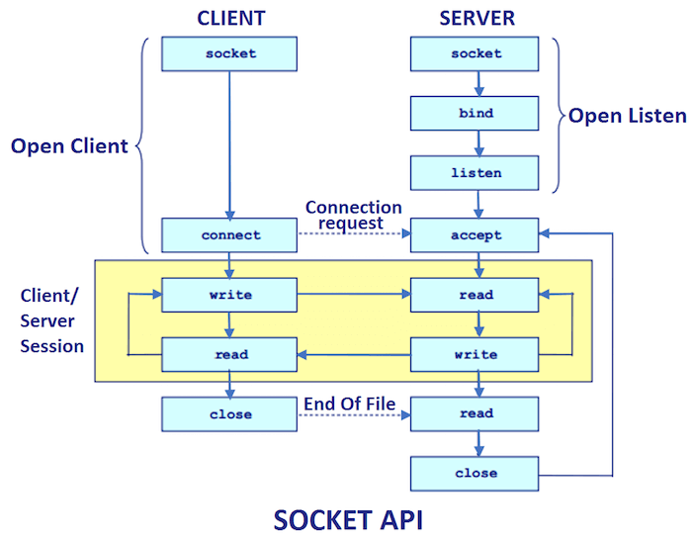
Socket Programming Flow
Domain – AF_UNIX
Protocol - SOCK_STREAM
[2] https://www.javatpoint.com/socket-programming
Fig: SOCKET API [2]

Slide 10
Server
1 . Socket creation:
server_fd = socket(AF_UNIX, SOCK_STREAM, 0);
2 . Binding to pathname:
server_address.sun_family = AF_UNIX;
strncpy(server_address.sun_path,SOCKET_NAME, sizeof(server_address.sun_path)-1);
bind(server_fd, (const struct sockaddr *)&server_address, sizeof(server_address));

Slide 11
Server
3. Listen:
listen(server_fd, 1);
4 accept:
client_fd = accept(server_fd, NULL, NULL);
5 Read/Write:
write(client_fd, msg, strlen(msg));
Read(client_fd, msg, strlen(msg));
6 Close:
Close(server_fd);

Slide 12
Client
1 Socket Creation:
fd = socket(AF_UNIX, SOCK_STREAM, 0);
2 connect:
connect(fd, (struct sockaddr *) &server_address, sizeof(server_address));
3 Read/Write:
write(fd, msg, strlen(msg));
Read(fd, msg, strlen(msg));
6 Close:
Close(fd);

Slide 13
Examples
https://man7.org/linux/man-pages/man7/unix.7.html
https://github.com/praveensankar/IN3230
Linux man page for the system calls and commands
Maybe some random online tutorials and blogs !

Slide 14
Thank You

